Slide 1
DIRECTI
CODING ROUND PROCESS

Slide 2
Step 1
Log in to CodeChef (www.codechef.com)
Step 2
Go to the contest link
www.codechef.com/DI15R067

Slide 3
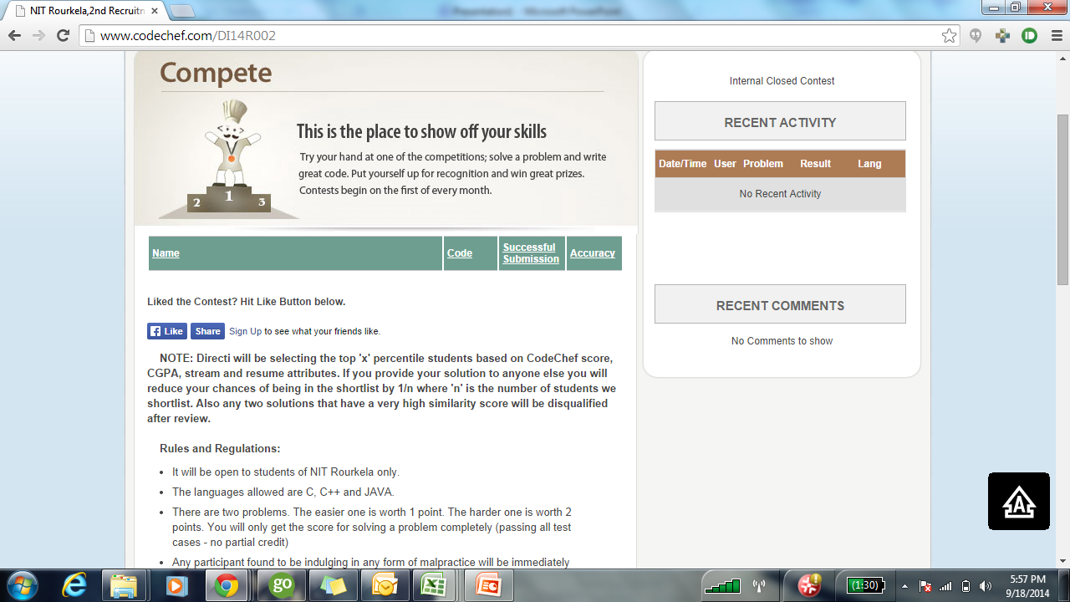
Step 4 : Read the instructions carefully

Slide 4
Step 5
Refresh the page at the start time of the test.
Step 6
You will have 3 questions to attempt.
Step 7
Click on the problems to view the question

Slide 5
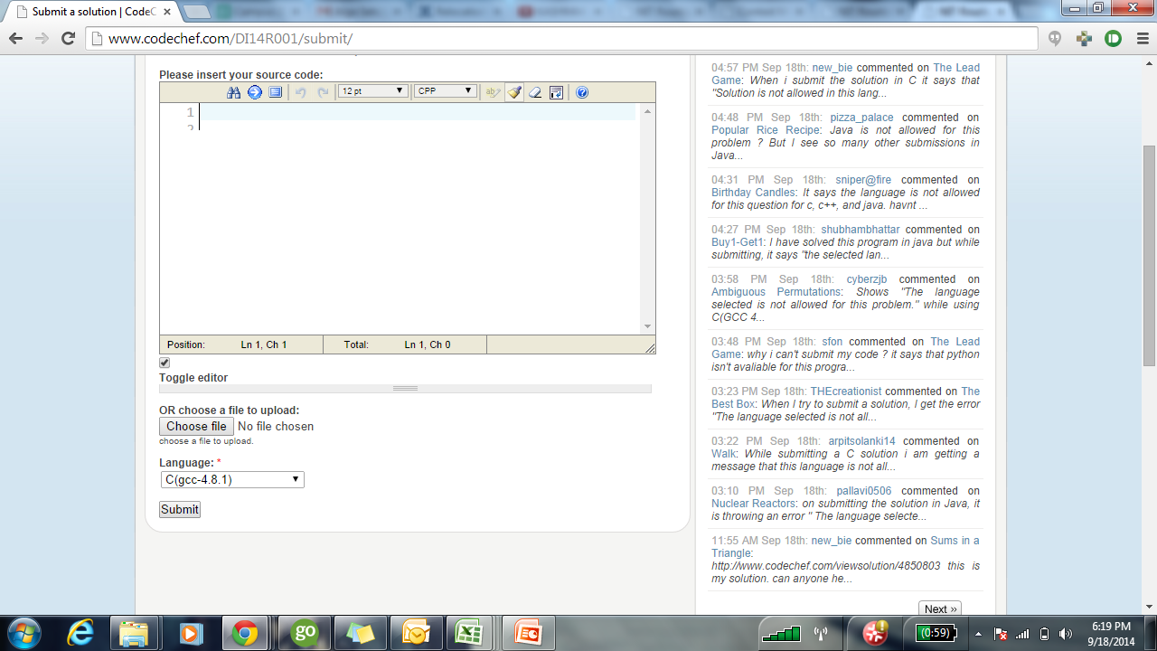
Step 8 : On clicking “Submit” you will see the CodeChef Compiler

Slide 6
Step 9
Select the language you would be coding in
Step 10
Paste/Upload your code into the compiler.
Step 11
Click on Submit

Slide 7
Please Note
In order to make a submission, it is mandatory to login to CodeChef.
If you are unable to view the “Submit” button or find it to be inactive, it means that you have not logged in to CodeChef.
The contest timer is global in nature which means that the test would end exactly 90 minutes from the start time mentioned in the email.
There is no restriction or penalty to the number of submissions you make for a problem. The last correct solution will be considered by the system.
Please make sure that all submissions are made within the stipulated 90 minutes.
No manual submissions via email would be entertained.
For any further questions you can write to joshua.he@directi.com / darryl.p@directi.com /ralph.p@directi.com

